Slide 1
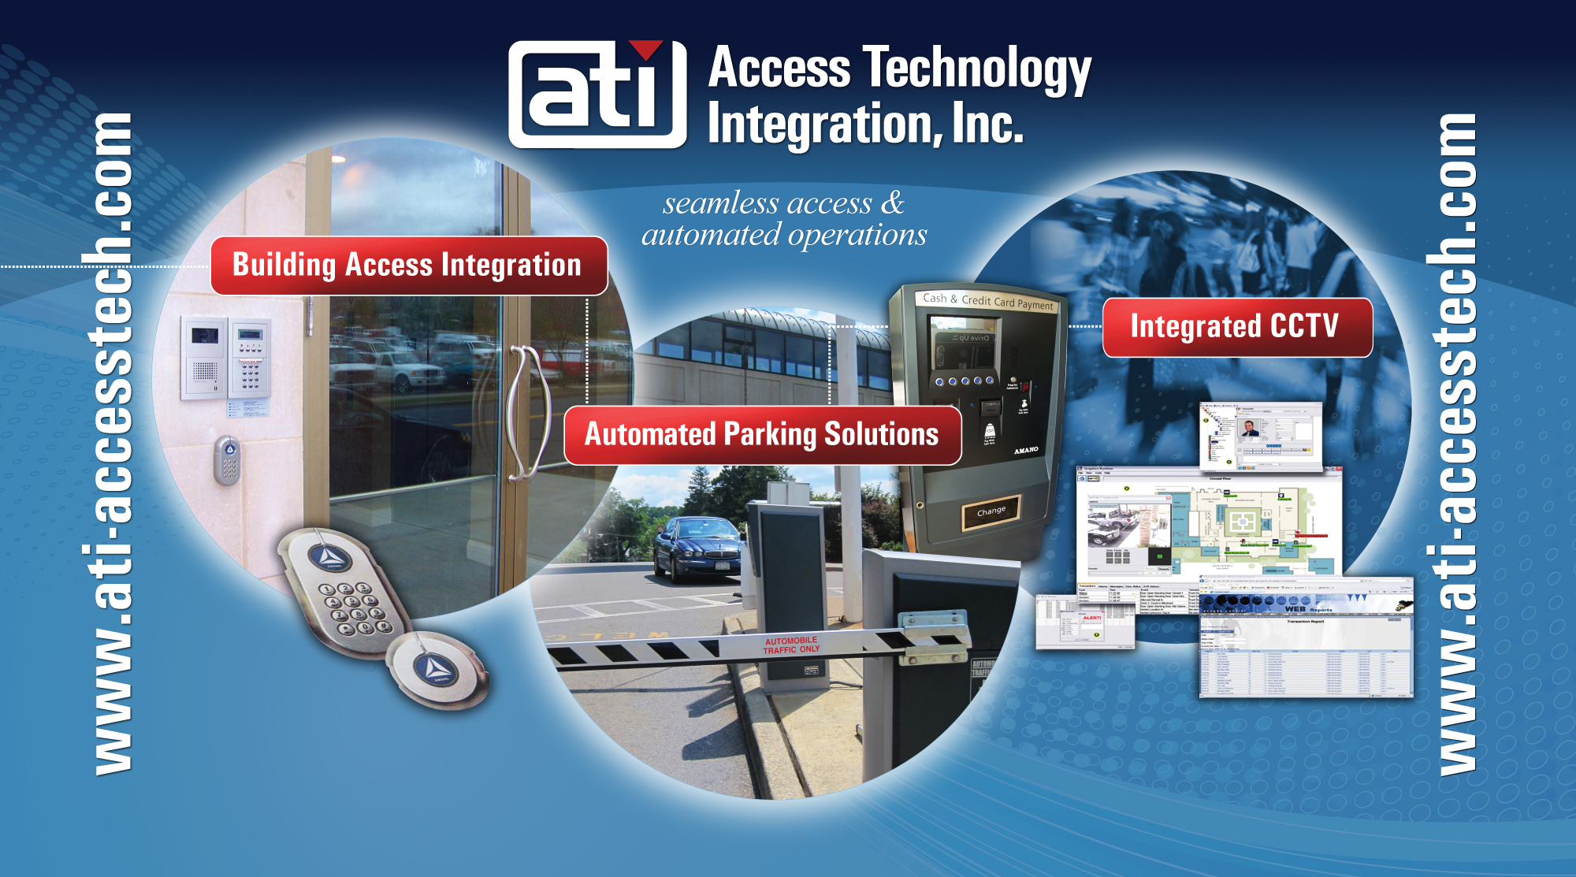

Slide 2
Access Technology Integration, Inc.
Access Technology Integration
Flowbird
Workshop

Slide 3
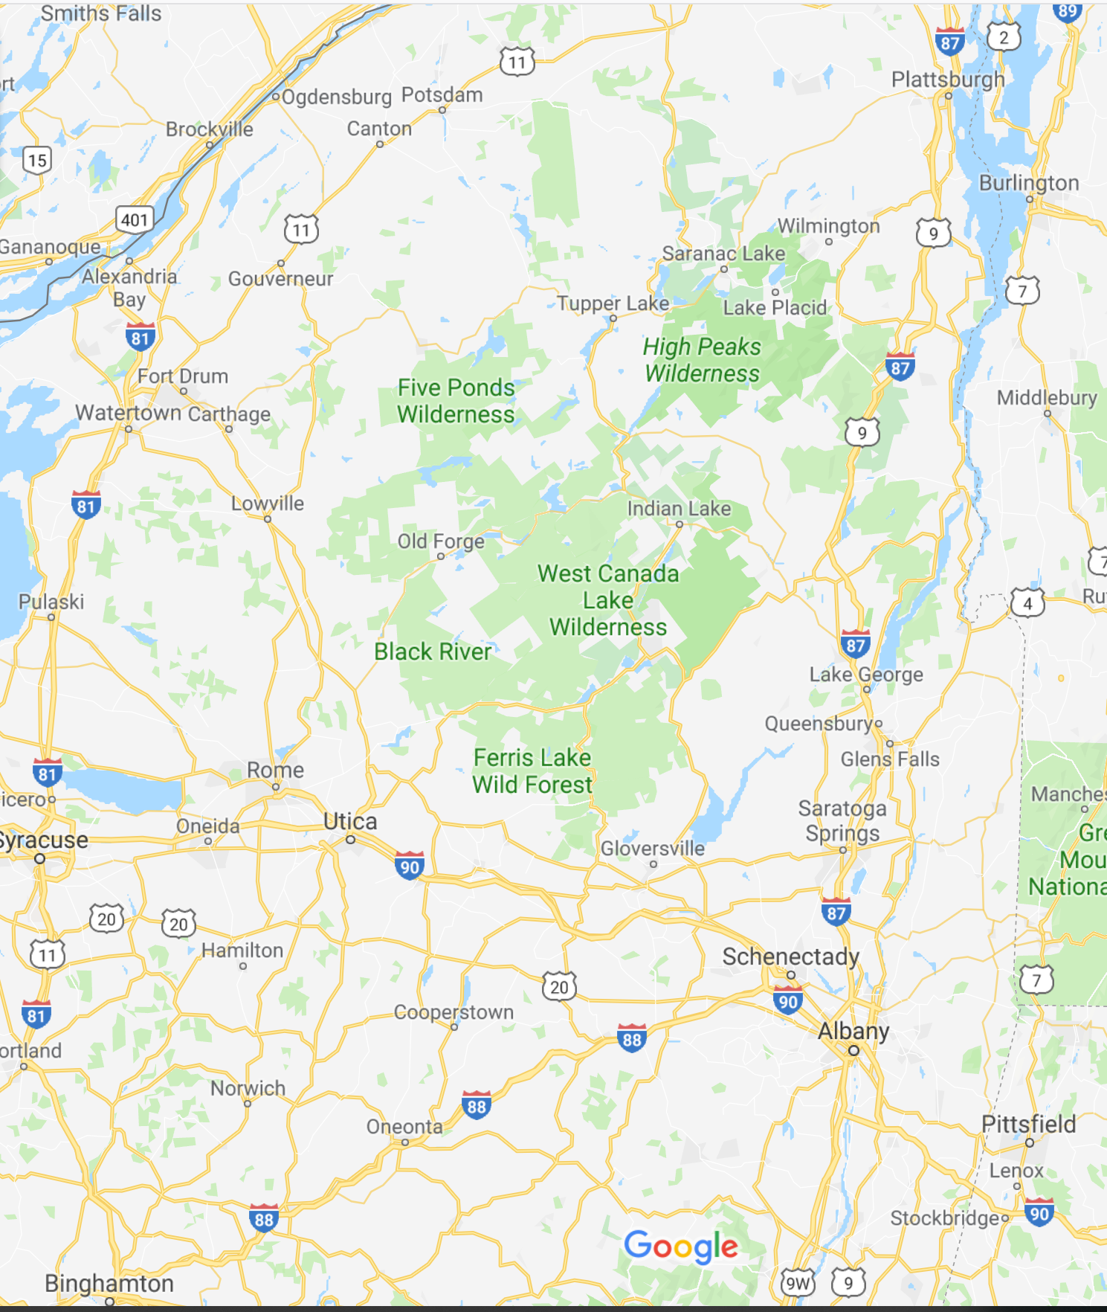
Access Technology Integration, Inc.
Regional leader of solutions for…..
  Parking Revenue Systems
  Building Access Controls
  CCTV
Notes:
Local Customers – Hudson Valley Rail Trail, City of Kingston, Village of New Paltz, SUNY New Paltz, City of Poughkeepsie, Dutchess County, Ulster County

Slide 4






Systems Integrator
Manufacturers
  Flowbird
  Flowbird APP
  Amamo McGann
  LiftMaster
  Transcore
  Magnetics
  HID

Slide 5
Flowbird Group
5,000 customers
75+ Countries
320 million in annual revenues
100 million weekly users
320,000 pay stations deployed
900 mobile app deployments

Slide 6

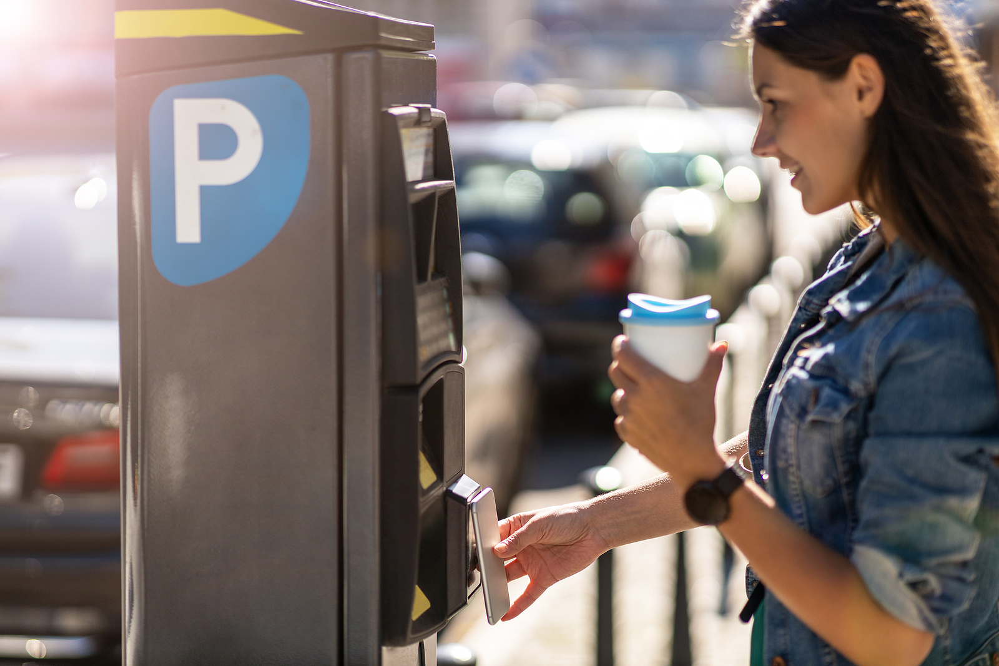

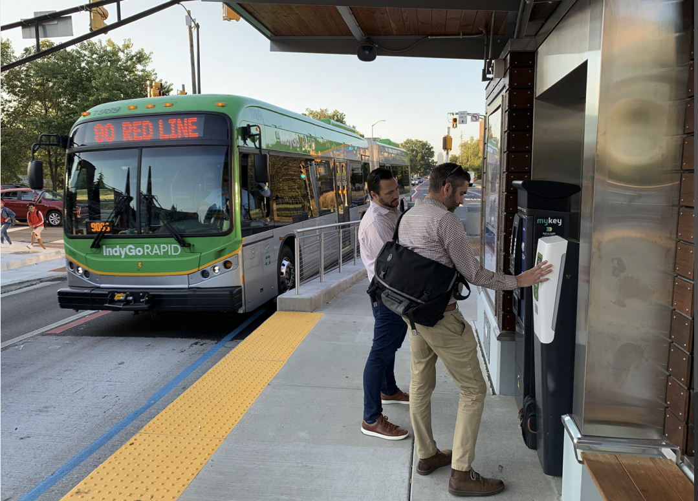

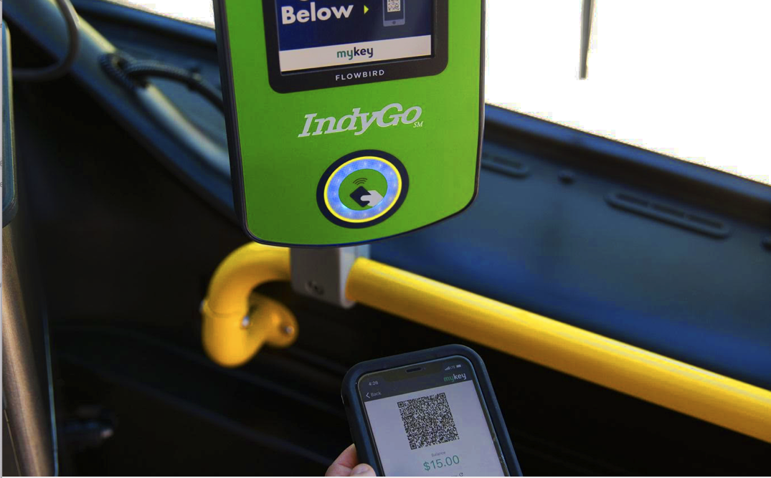
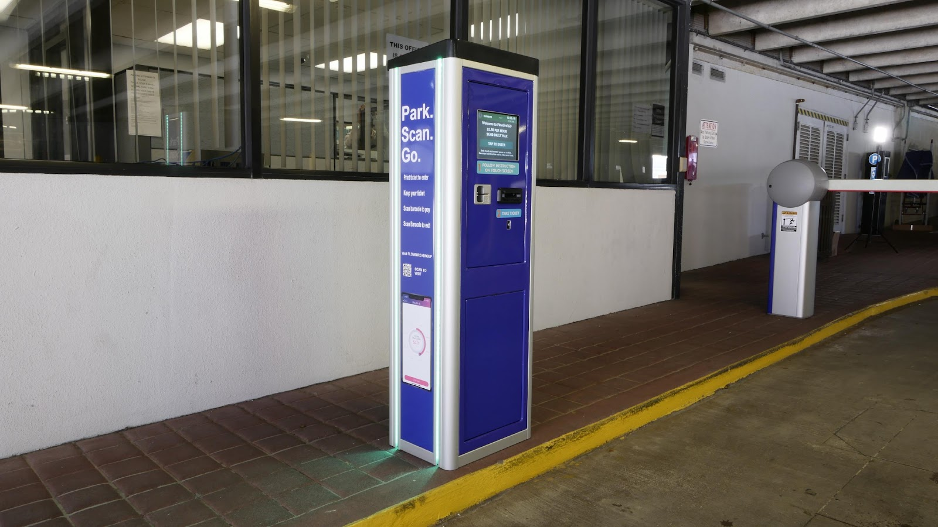

FLOWBIRD MOBILITY SOLUTIONS
KIOSKS/METERS MOBILE PAY FARE COLLECTION
OFF-STREET E-PERMITS OPEN PAYMENTS
Notes:
Industry trend – Understand, manage and provide a convenient means to move about a Cities.

Slide 7

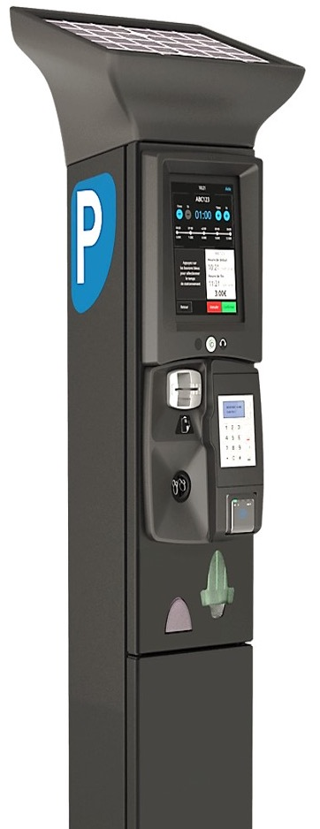
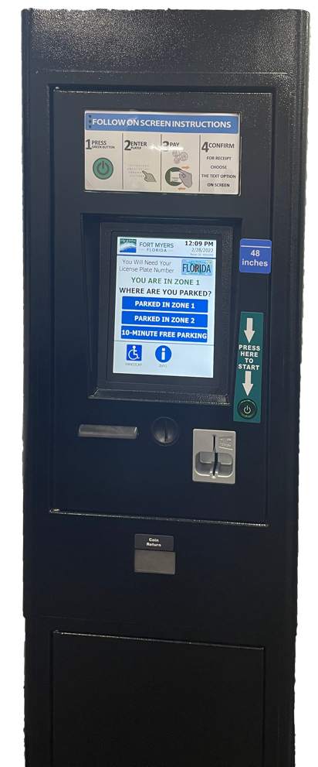


PAY STATION KEY FEATURES
High efficiency solar charging system
4G LTE wireless communications
Flexible user interface for various parking modes – Pay by Plate, Pay by Space, Pay & Display
9.7” Touch Screen Display
Multiple payment options including Coins, Bills, Credit/Debit, Contactless/NFC, Extend by Text
Stainless Steel, all weather design
Separately keyed maintenance and collection compartments
Double security vault access and optional Electronic locks`

Slide 8
Workshop
Reasons for Paid Parking
  Fiduciary Responsibilty
    Revenue Source
    Offset expenses
    Operational Efficiencies
  Community & Merchants
    Limited Parking
    Access to Parks & Pt. of Interest
    Convenience to Store Fronts

Slide 9
Workshop
Who….
  NYS Parks
    Minnewaska State Park Preserve
      The fee for parking at Minnewaska is $10 per car.
    WalkOver the Hudson
      Please follow posted signage for information about metering and parking availability.
    Hudson Valley Rail Trail
  Municipalities
  Colleges & Universities
  Private Entities

Slide 10
Workshop
Parking Rate(s)
  Flat Fee
  Stepped
  Variable
  Forced Rotation
  Extended Stay

Slide 11
Workshop
Enforcement
  Visual Inspection
  Handheld Device
  3rd Party

Slide 12
Further Questions…?

Slide 13
Citation Payments
Pay Citations at the pay stations
Direct integration with Citation Management Systems
Search by Plate or Citation number
Payments made in real-time

Slide 14
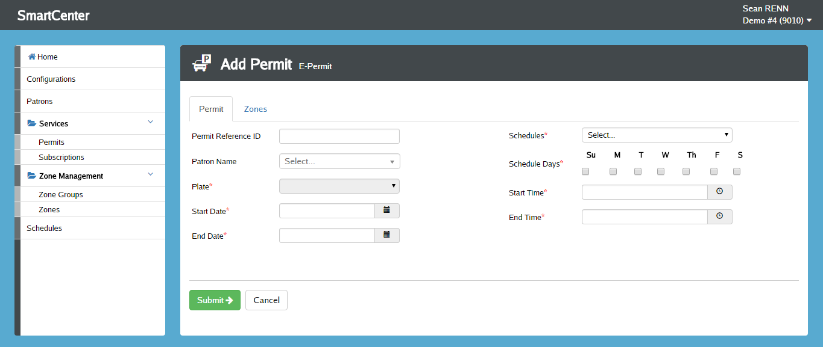
E-Permits
Eliminate consumables such as hang-tags and stickers
Flexible parameters
Integrates with citation issuance/LPR (license plate recognition) systems

Slide 15









Key Customers

Slide 16








Other key ATI Customers

